Slide 1

Development of machine learning models to process Electronic Health Records – Imputation Strategies
Week 21 Meeting, 14/3/2021

Slide 2
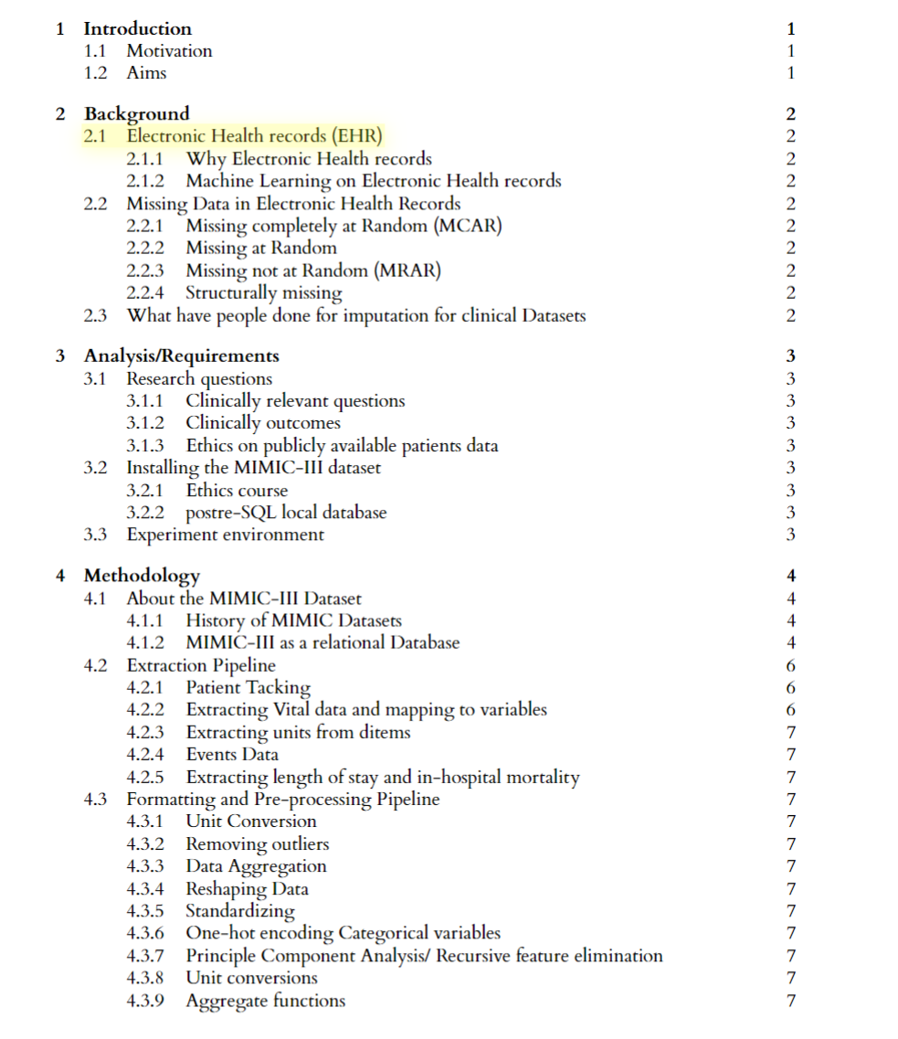
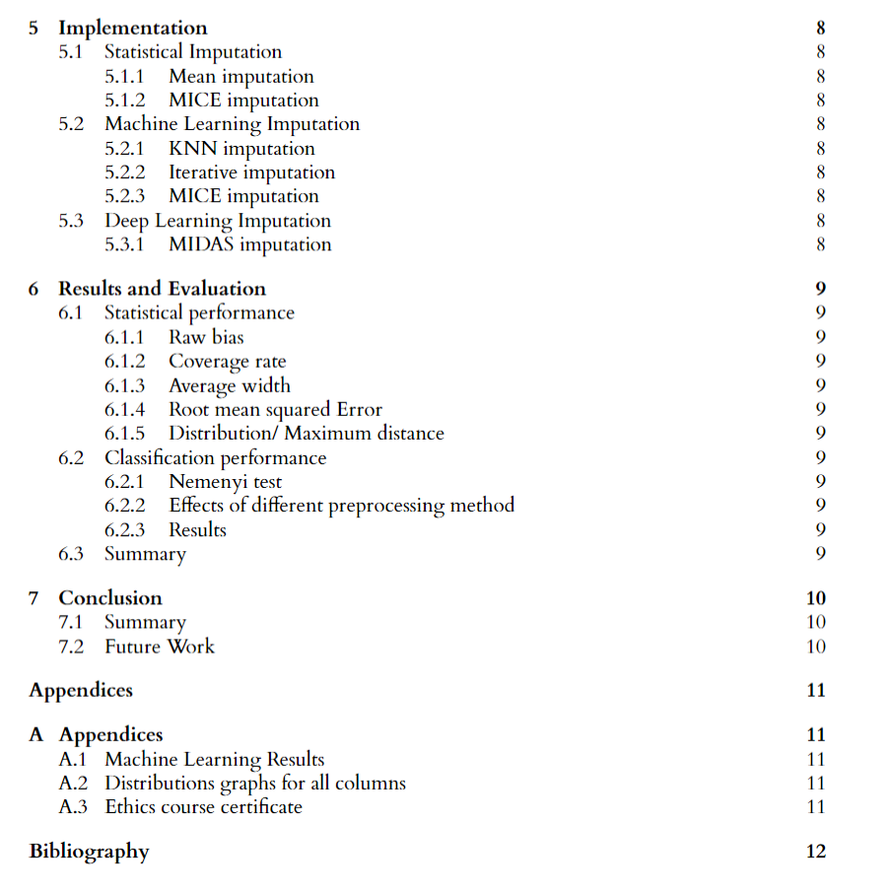

Slide 3
How is the cohort selection decided
Why age>15
Not child, still in development stage, measurements will be different
Why admission more than 1 day and less than 15 days?
Fewer recordings will not have enough information for machine learning models to learn a pattern?
Less than 1 day, might be a mistake
More than 15 days is very extreme cases, based on clinical protocols published in other paper
Putting code in dissertation
Should I put the full extraction sql query or create diagrams for it instead for easier understanding with no coding background
Should I be using figures of the data frame when explaining the pipeline

Slide 4
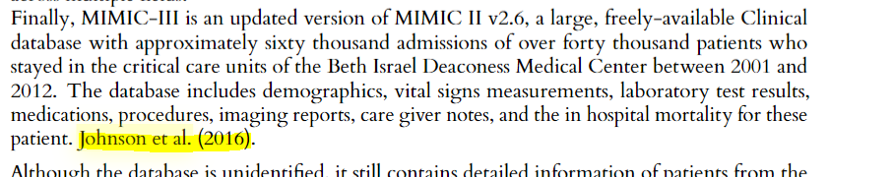
[5]

Slide 5
Discussion
Problem of needing a baseline to start with

Slide 6
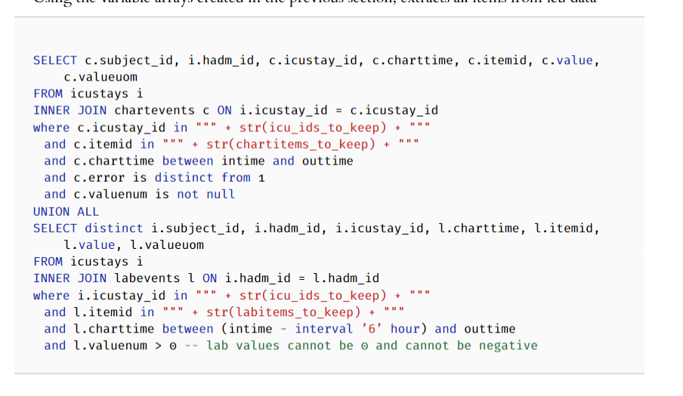

Slide 7

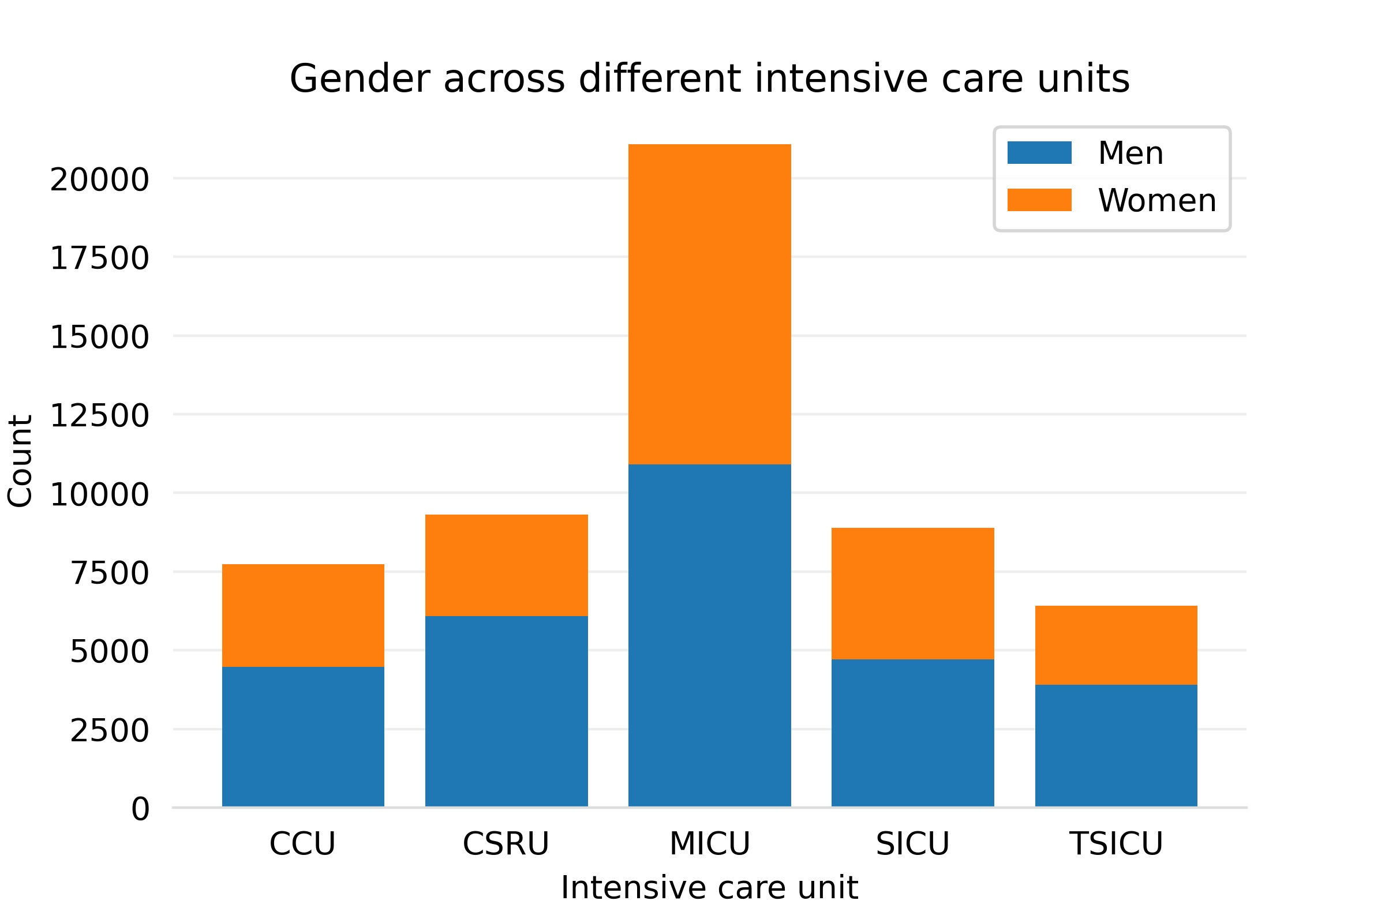
MIMIC-III: Gender per critical care unit
Notes:
https://github.com/MIT-LCP/mimic-iii-paper/blob/master/notebooks/MIMIC-paper-tables.ipynb

Slide 8
MIMIC-III: Gender per critical care unit
Notes:
https://github.com/MIT-LCP/mimic-iii-paper/blob/master/notebooks/MIMIC-paper-tables.ipynb

Slide 9
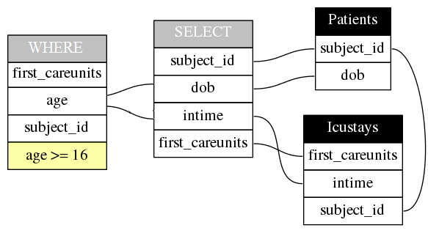
MIMIC-III: Distinct Patients’ Hospitalisations
Notes:
https://github.com/MIT-LCP/mimic-iii-paper/blob/master/notebooks/MIMIC-paper-tables.ipynb

Slide 10
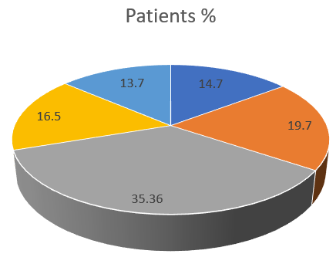
MIMIC-III: Distinct Patients’ Hospitalisations
Total patients: 38597
Notes:
https://github.com/MIT-LCP/mimic-iii-paper/blob/master/notebooks/MIMIC-paper-tables.ipynb

Slide 11
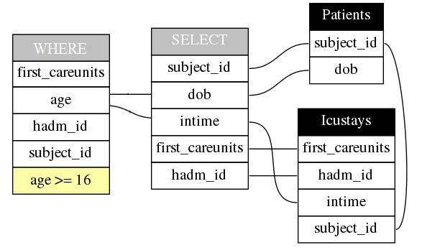
MIMIC-III: Hospital Admissions
Notes:
https://github.com/MIT-LCP/mimic-iii-paper/blob/master/notebooks/MIMIC-paper-tables.ipynb

Slide 12
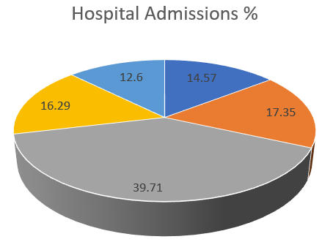
MIMIC-III: Hospital Admissions
Total hospital admissions: 49785
Notes:
https://github.com/MIT-LCP/mimic-iii-paper/blob/master/notebooks/MIMIC-paper-tables.ipynb

Slide 13
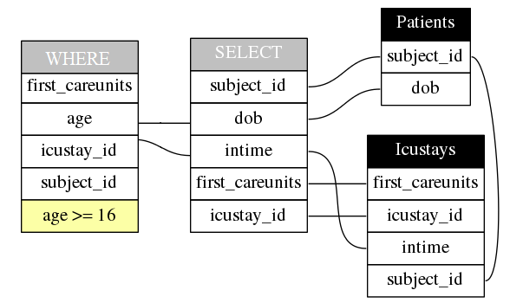
MIMIC-III: Distinct ICU Admissions
Notes:
https://github.com/MIT-LCP/mimic-iii-paper/blob/master/notebooks/MIMIC-paper-tables.ipynb

Slide 14
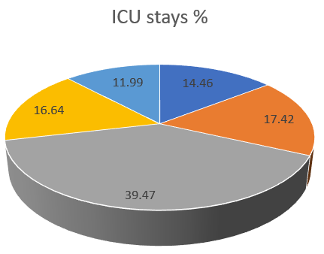
MIMIC-III: Distinct ICU Admissions
Total ICU stays: 53423
Notes:
https://github.com/MIT-LCP/mimic-iii-paper/blob/master/notebooks/MIMIC-paper-tables.ipynb

Slide 15
MIMIC-III: Hospitalisations
Total patients: 38597
Total hospital admissions: 49785
Total ICU stays: 53423
Notes:
https://github.com/MIT-LCP/mimic-iii-paper/blob/master/notebooks/MIMIC-paper-tables.ipynb

